Slide 1

Unacceptable Creditors
Updated 11/19/2025
These creditors cannot be enrolled, as these are creditors that we don't work with. The creditor will not negotiate any settlements on these accounts.
Unacceptable Creditors:
Aloha Pacific FCU
American Education System (AES)
Armed Forces Bank
Army Air Force Exchange Lease/Rental Agreements (MUST BE IN COLLECTIONS)
Army National Bank
Broadview FCU
Cap Com FCU
Denefits LLC
Diamond Resorts
EdFinancial Services
EnerBank
Farmers Home Furnishing / Furniture
Fast and Reliable Cash Advance
Frost Bank / Frost National Bank (Student Loans)
GoodLeap (MUST BE IN COLLECTIONS)
MEDICAL PAYMENT DATA
Members 1st FCU / Members 1st CU
Military Star
Mosaic Tower Loans
Nebraska Furniture Mart
OneLoan Direct
OneMain – ***Secured Loans, Installment Loans, and Note Loans
Police & Fire CU
Schlumberger Employees CU
Security Finance (MUST BE IN COLLECTIONS)
Self-Reported (Telecom)
Self-Reported (Utility)
Southeast Toyota Finance
Special Finance Company / Special Finance
State Employees CU / FCU (SECU / SEFCU)
Timeshares
Virginia CU / FCU
.
Notes:
There are many many creditors that we can add to our program, however there are a few that we can’t add.
Here is a list for you – and I also have it uploaded on SharePoint so that its easily accessible. Please always double check this list.

Slide 2
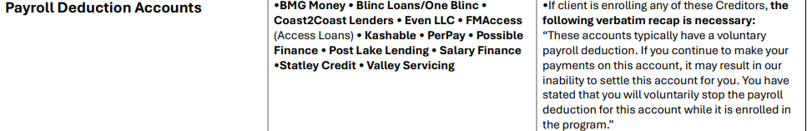
Additional Requirements
Updated 9/24/2025
Creditors that have additional requirements
OneMain Financial Enrollment Requirements:
  Accounts appearing as “Secured” on CR will require original loan docs to verify collateral regardless of balance.
  Accounts appearing as “Unsecured” or in a collection’s status will not require original loan docs.
Banker Healthcare Group
  Files containing BHG qualify for a max term of months
.
Recap script is required of clients adds these following creditors
Notes:
There are many many creditors that we can add to our program, however there are a few that we can’t add.
Here is a list for you – and I also have it uploaded on SharePoint so that its easily accessible. Please always double check this list.

Slide 3
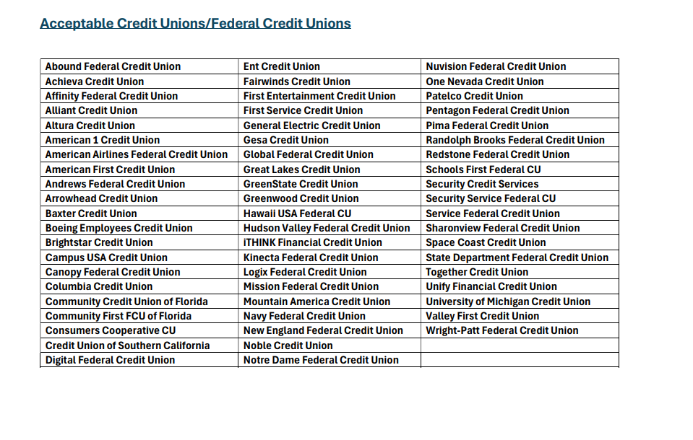

Slide 4
